Slide 1
The Hubble Flow

Slide 2
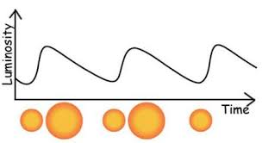
Hubble Flow
Hubble observed a class of variable stars known as Cepheid variables (discovered by Henrietta Swan Leavitt in 1908)
Cepheid’s are pulsating stars which have a direct relationship between the pulsation and the brightness
This allowed them to be used as Standard candles –
  where if we know the period,
  we can work out the true luminosity
  (absolute magnitude),
  and if we know this we can work out
  the distance to the star

Slide 3
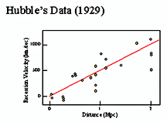
Hubble Flow
When Hubble observed these stars he worked out that most of them were in fact outside of our galaxy
Using these stars he measured the distances to their host galaxies and found that there was a relationship between the distance to the galaxies and the velocity of the system…
The further away they were –
the faster they were moving…

Slide 4
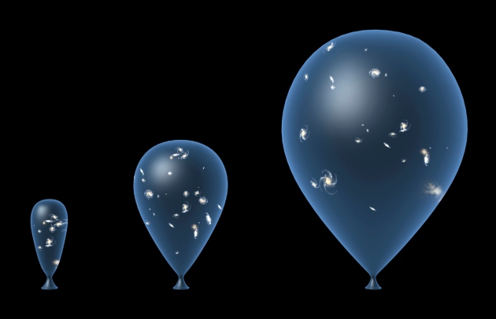
Universal Expansion
Despite the fact that Hubble himself was not in favour of the idea that his discovery ‘proved’ universal expansion, it is the widely accepted piece of evidence that is strongly in favour of it.
The expansion of the Universe is quite a tricky one to imagine, the best way to envisage it is through the ‘Balloon Model’:
Not only does the distance between
two galaxies increase, but all of the
intermediate space in between
expands. This is just like the balloon
universe image to the right; the
distance between each galaxy
increases but the balloon material
itself also expands as it inflates.
TAKE 27 LTD/SPL

Slide 5
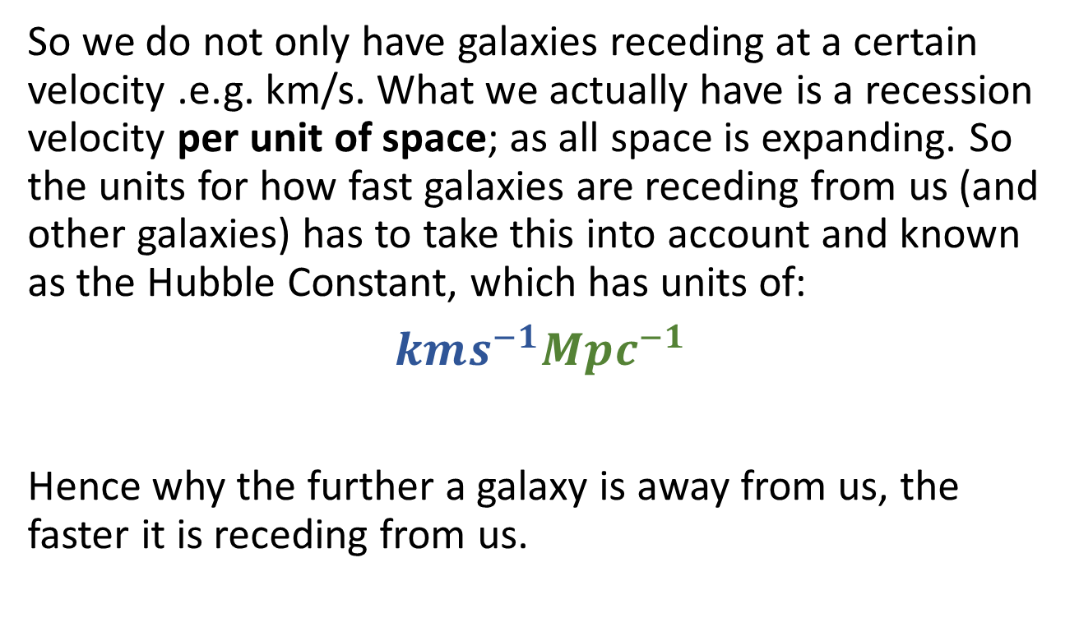
Universal Expansion
So we do not only have galaxies receding at a certain velocity .e.g. km/s. What we actually have is a recession velocity per unit of space; as all space is expanding. So the units for how fast galaxies are receding from us (and other galaxies) has to take this into account and known as the Hubble Constant, which has units of:
$kms^{−1}Mpc^{−1}$
Hence why the further a galaxy is away from us, the faster it is receding from us.
Recession velocity per unit of space

Slide 6
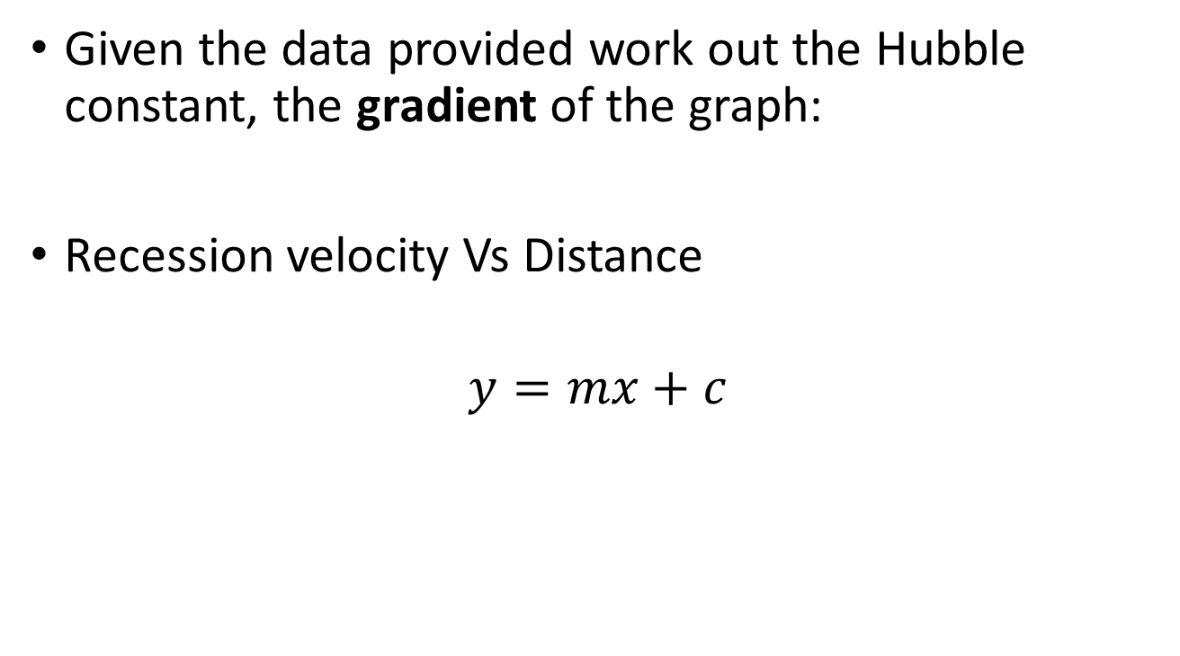
Exercise
Given the data provided work out the Hubble constant, the gradient of the graph:
Recession velocity Vs Distance
$$y=mx+c$$

Slide 7
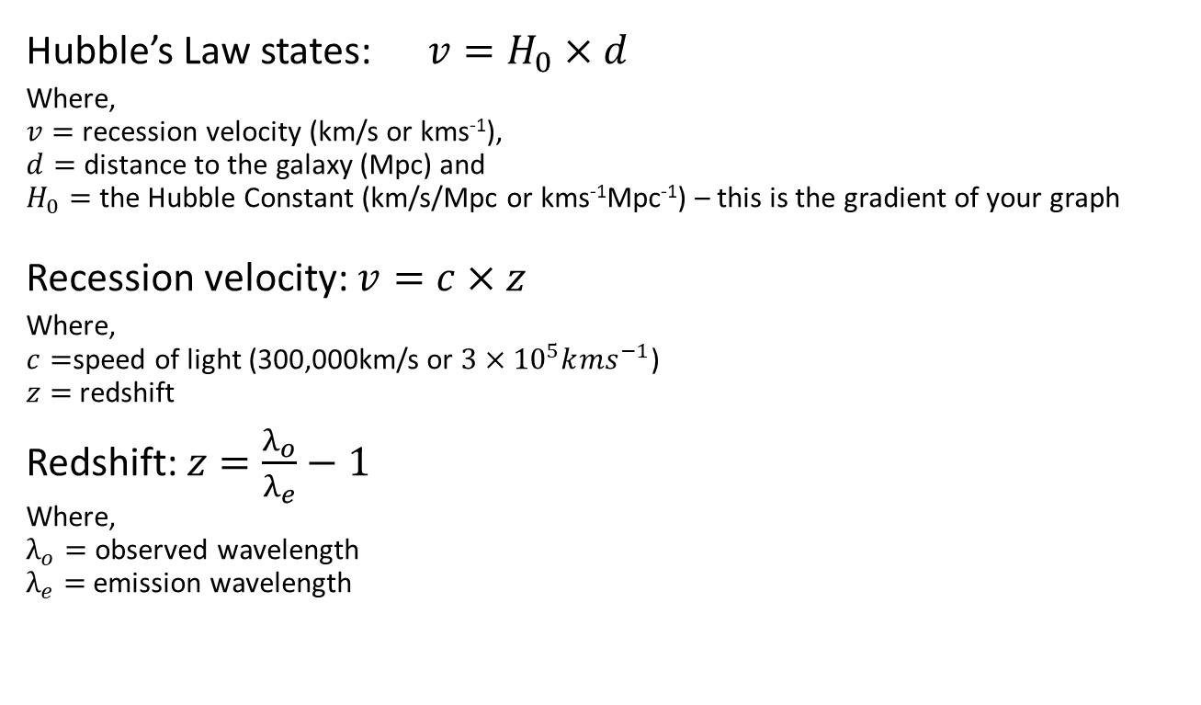
Helpful Equations:
Hubble’s Law states:$v=H_{0}×d$
Where,
$v=$ recession velocity (km/s or kms⁻¹),
$d=$ distance to the galaxy (Mpc) and
$H_{0}=$ the Hubble Constant (km/s/Mpc or kms⁻¹Mpc⁻¹) – this is the gradient of your graph
Recession velocity: $v=c×z$
Where,
$c=$speed of light (300,000km/s or ${3×10}^{5}k{ms}^{−1}$)
$z=$redshift
Redshift: $z=\frac{λ_{o}}{λ_{e}}−1$
Where,
$λ_{o}=$ observed wavelength
$λ_{e}=$emission wavelength

Slide 8
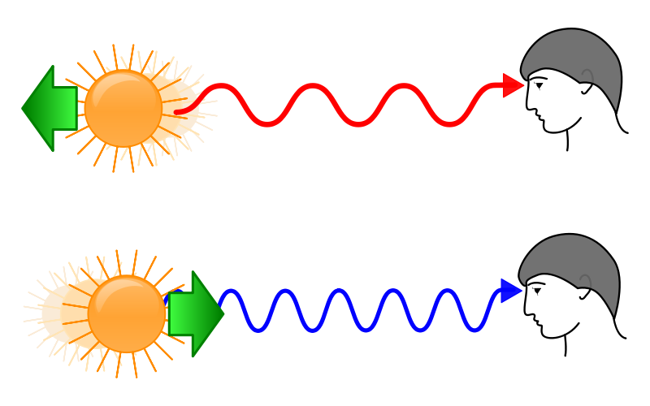
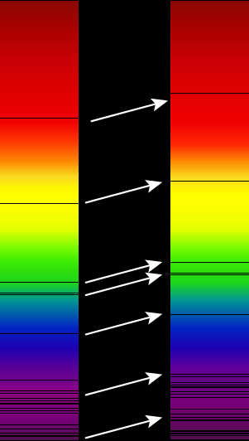
Redshift
When an object is moving away the light increases in wavelength
Hot objects, like stars also emit radiation (light) at specific wavelengths, known as emission lines; and obstruct light at specific wavelengths, known as absorption lines
These lines also move to the longer wavelength part of the spectrum – they shift to the red

Slide 9
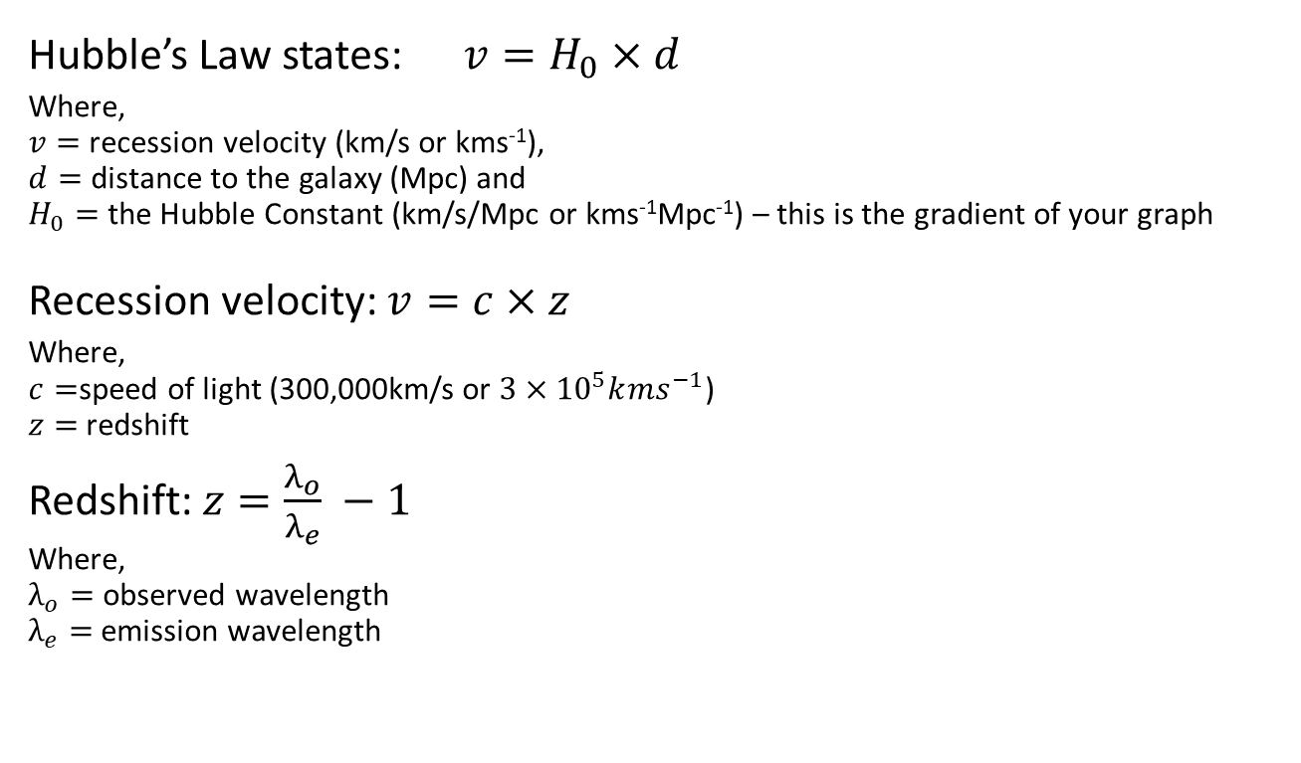
Helpful Equations:
Hubble’s Law states:$v=H_{0}×d$
Where,
$v=$ recession velocity (km/s or kms⁻¹),
$d=$ distance to the galaxy (Mpc) and
$H_{0}=$ the Hubble Constant (km/s/Mpc or kms⁻¹Mpc⁻¹) – this is the gradient of your graph
Recession velocity: $v=c×z$
Where,
$c=$speed of light (300,000km/s or ${3×10}^{5}k{ms}^{−1}$)
$z=$redshift
Redshift: $z=\frac{λ_{o}}{λ_{e}} −1$
Where,
$λ_{o}=$ observed wavelength
$λ_{e}=$emission wavelength

